Slide 1
16S rRNA and the microbiome
Adrian Verster (averster@uw.edu)
April 25th, 2017
Notes:
I am Adrian a post-doctoral fellow in the Borenstein lab. I work on trying to understand the chaotic mess known as microbiome data and I create computational methods to impose order on it.
My background is a combination of biology and math, but I’ve been interested in all sorts of things over the years from the evolution of C. elegans to algorithms for microscopy data analysis.
And my goal with this class is that you what the microbiome is, how messy and untamed the data is, and of course algorithms for how to deal with it which is the whole point of this course.

Slide 2
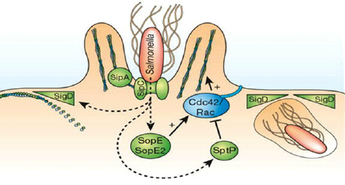
Microbiology has a long standing interest in pathogens
Kaur and Jain 2012
Notes:
For a long time, the relevance of microbiology to human health was about infection. Bacteria like Salmonella - diahhrea, Vibrio - cholera, mycobacterium - teberculosis, Yersinia pestis - plague. These bacteria are pathogens because they invade human tissues, and has been a lot of study of the mechanisms that allow bacteria to invade the human body. Microbiologists talk can pathogenicity islands which encode the genes needed to invade the human body, and an transfer from organism to organism and turn them into pathogens.
The T3SS, a long tormentor of of undergraduates, is one of these molecular mechanisms which has a huge amount of scientific blood and sweat put into it.

Slide 3

The microbiome
Notes:
But its only a small number of bacteria that do this, most have no interest in causing disease. They have their own lives, they have competitors and friends, they have food requirements and waste products they need to deal with. They live in complex communities, which are as rich biologically as the African savanna, the Amazonian rain forest or the great barrier reef.
And these ecosystems exist all over our body. On our skins, in our mouths and in our intestines. Probably at least 30 trillion.
More recently, MIcrobiologists have been interested in understanding these ‘other’ non-pathogenic bacteria that live absolutely everywhere. Why might these bacteria matter?

Slide 4
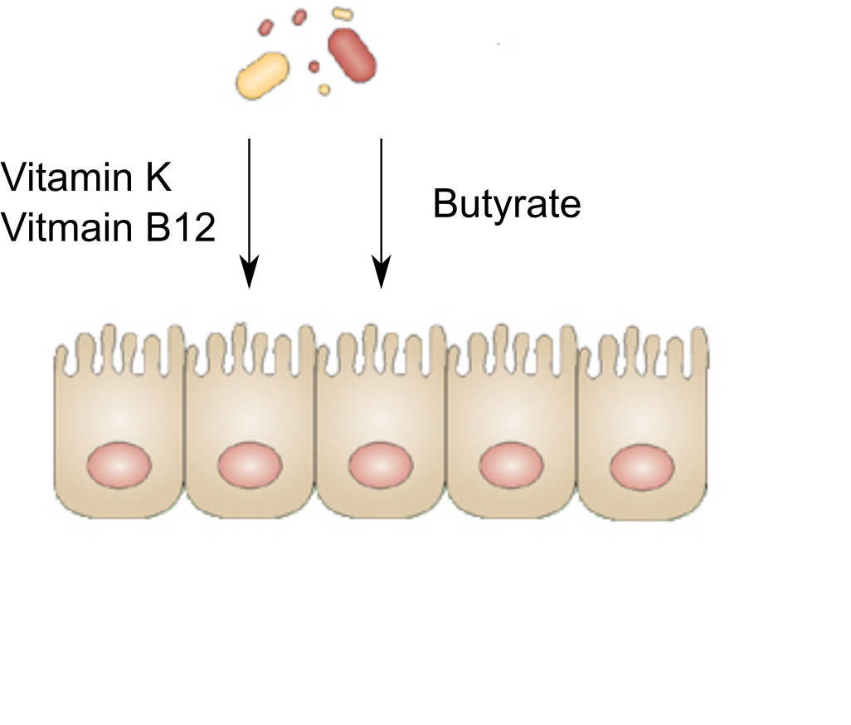
Why might the microbiome matter?
Notes:
These microbes aren’t just passengers, they’re not irrelevant freeloaders that detract from the perfected human form. They are little biochemists that live within us and engage in give and take with the human cells that surround them. Essential vitamins. Food for the intestinal cells.
Immune development!

Slide 5
Outline
t
Bacterial species
Understand the difference between prokaryotic and eukaryotic species
16S rRNA sequencing – the standard method
Understand the standard method to analyze 16S sequencing data
Understand dimensionality reduction
16S rRNA sequencing – an alternative method
Understand the shortcomings of the standard method
Understand a more sophisticated alternative method

Slide 6
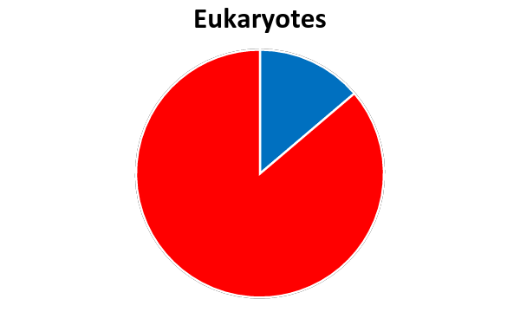
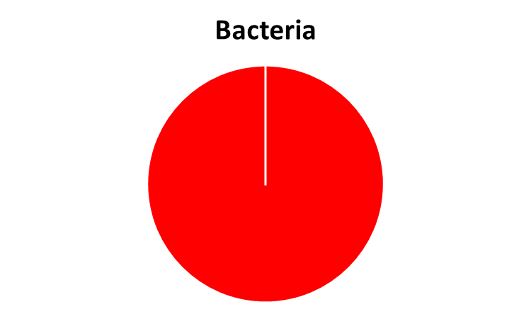
How many prokaryotes exist in nature?
1.2 million described
11,000
described
7.5 million undescribed
10¹²
undescribed
Mora et al. 2011
Locey and Lennon 2016
Notes:
We know a lot about eukaryotes, as naturalists have been working for hundreds of years to describe the diversity of the earth.
In the old dayss explorers would return from unknown continents with a ship full of absolutely bizzare animals such as the kangaroo, but those days are past us. There are insects and protists left to find, but we actually know much of the diversity that’s out there.
For bacteria….

Slide 7
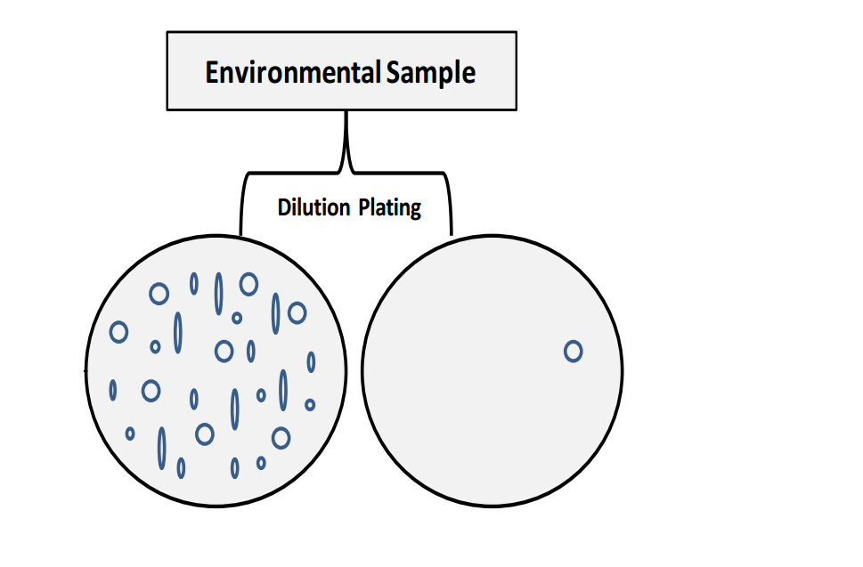
The great plate count anomaly
Harwani 2013
Notes:
We actually know very little about microbial ecosystems …

Slide 8
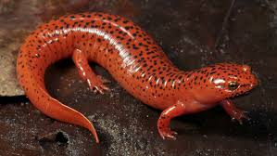
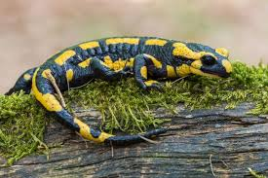
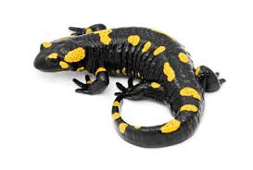
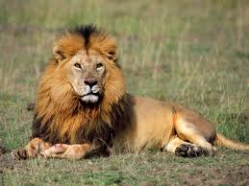
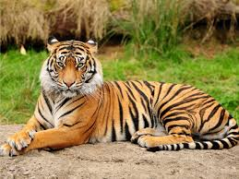
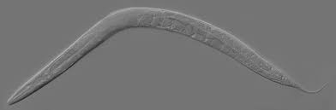
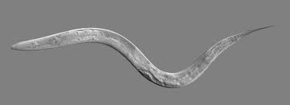
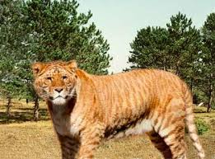
What is a (eukaryotic) species?
Phenotype based definition
Biological species concept
???
Notes:
So back in the good old days, when we didn’t know about evolution, when species of animals and plants had clean, unambiguous fits into the god given great chain of being, naturalists would go out and try to organize the animals and plants they were finding into groups, that is into species. If you find a salamander in a pond, and later on you find another salamander that looks just like it, well they are probably both an instance of the same thing, that is the same species. Now the challenge with this poses, philosophically, is fairly clear – when is it the same enough? Salamander paws. But … someone else might say something different.
But still, creating species like this is a useful way to understand the world.
Once evolution hits, we can have the biological species concept. Species are evolving, and if they evolve down a different path, there will reach a point where they are no longer compatible with one another, and can’t interbreed. This is of fundamental importance to evolutionary biology, geographical isolation breeds speciation, and then you can study speciation at the molecular level when incompatibilities between the father’s and mother’s genome become apparent.
But practically? Worms yes. Salamanders no. Many other animals just will not mate in captivity. Big problem for zoos.
And what exactly is the distinction between a population and a species with this? Does it matter than they COULD interbreed even when they DON’T? Its just a matter of time before some subtle molecular incompatibility pops up.
And this just dosen’t apply to asexual organisms

Slide 9
What is a (prokaryotic) species?
Phenotype based definition
Notes:
Same phenotype thing applies to bacteria. Metabolites used. Gram positive/negative etc.
Early days of genomics, DNA-DNA hyb . 70% of genomes combine, then they would roughly match the phenotype based groups.
But modern studies use the 16S gene. Why 97% ID? But they won’t call these groups species, instead they use OTUs

Slide 10
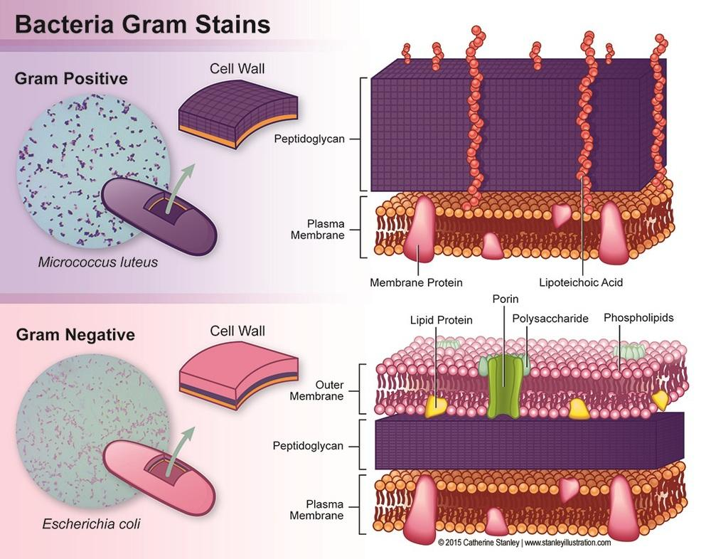
What kind of phenotypes are there for prokaryotes?

Slide 11
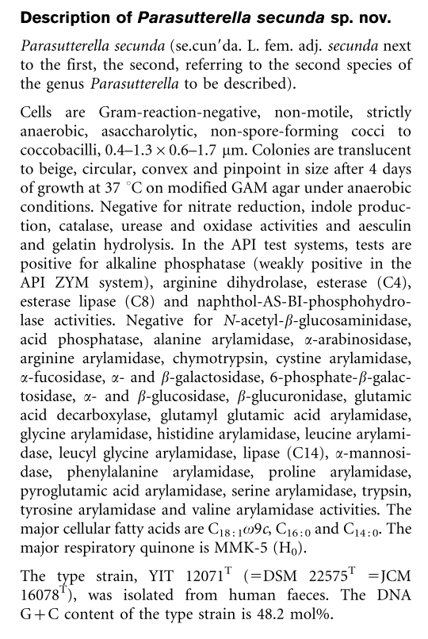
What kind of phenotypes are there for prokaryotes?

Slide 12
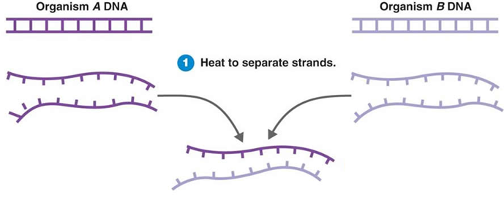
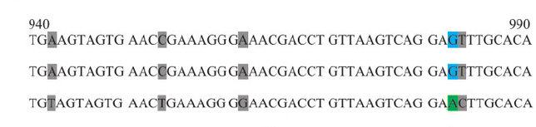
What is a (prokaryotic) species?
Phenotype based definition
DNA-DNA hybridization of 70%
16S identity of 97%
Notes:
Same phenotype thing applies to bacteria. Metabolites used. Gram positive/negative etc.
Early days of genomics, DNA-DNA hyb . 70% of genomes combine, then they would roughly match the phenotype based groups.
But modern studies use the 16S gene. Why 97% ID? But they won’t call these groups species, instead they use OTUs

Slide 13
Definitions
Species - A group of prokaryotes that taxonomist has characterized based on phenotypes
Strain - A representative prokaryote from the species group
Operational taxonomical unit - A group of 16S sequences with at least 97% ID

Slide 14
Why the 16S rRNA gene?
Found in all prokaryotes
Conserved function
Some sites which evolve neutrally
Evolves resolution to discriminate between species

Slide 15
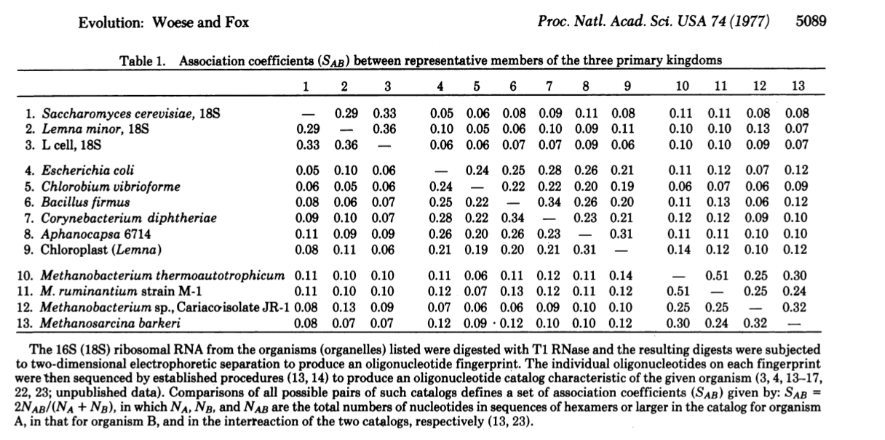
A long history of 16S phylogenetics

Slide 16
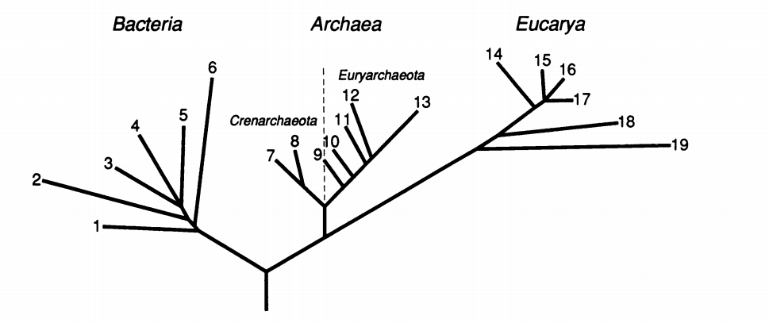
Prior to this, prokaryotes were all lumped together
Animalia, Fungi, Plantae, Protista, Monera (Whittaker 1969)

Slide 17
Outline
Bacterial species
Understand the difference between prokaryotic and eukaryotic species
16S rRNA sequencing – the standard method
Understand the standard method to analyze 16S sequencing data
Understand dimensionality reduction
16S rRNA sequencing – an alternative method
Understand the shortcomings of the standard method
Understand a more sophisticated alternative method

Slide 18
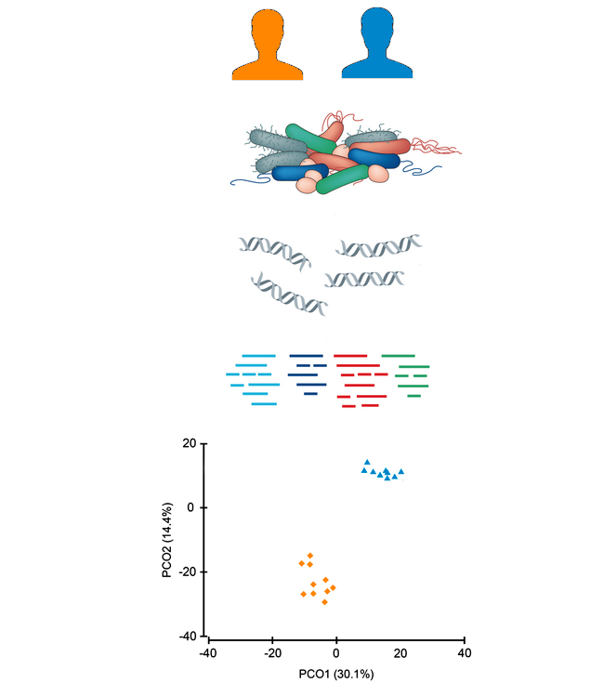
A standard metagenomics study
Study population
Stool samples
Environmental DNA
16S OTUs
Compare the study populations

Slide 19
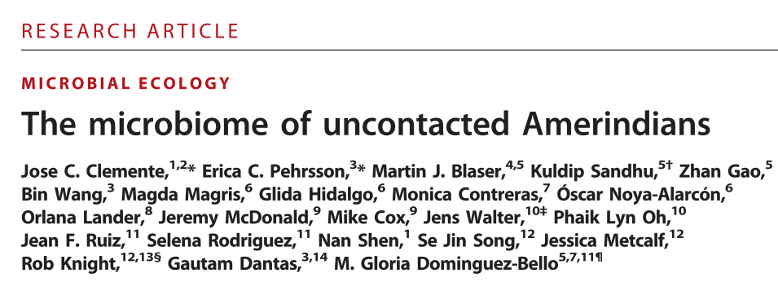
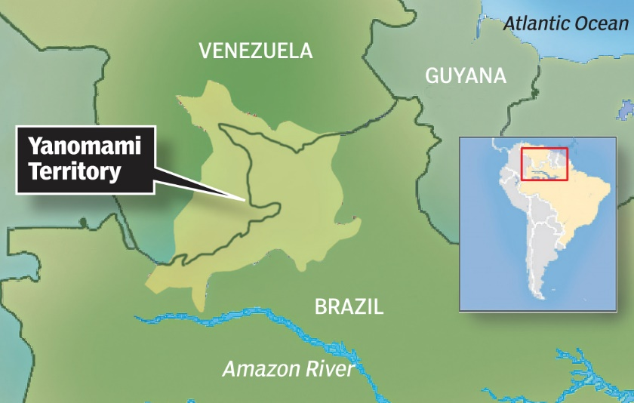
Question – how has industrialization changed the gut microbiome?
We characterize the fecal, oral, and skin bacterial microbiome and resistome of members of an isolated Yanomami Amerindian village with no documented previous contact with Western people

Slide 20
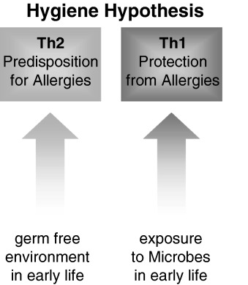
The hygiene hypothesis

Slide 21
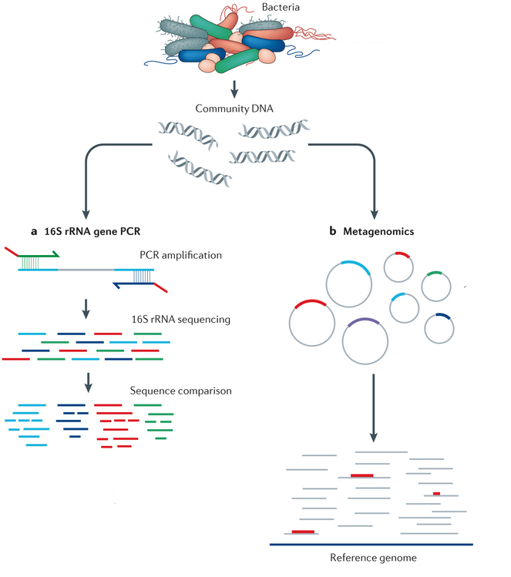
A modern metagenomics sequencing pipeline
Lasken and McLean 2014

Slide 22
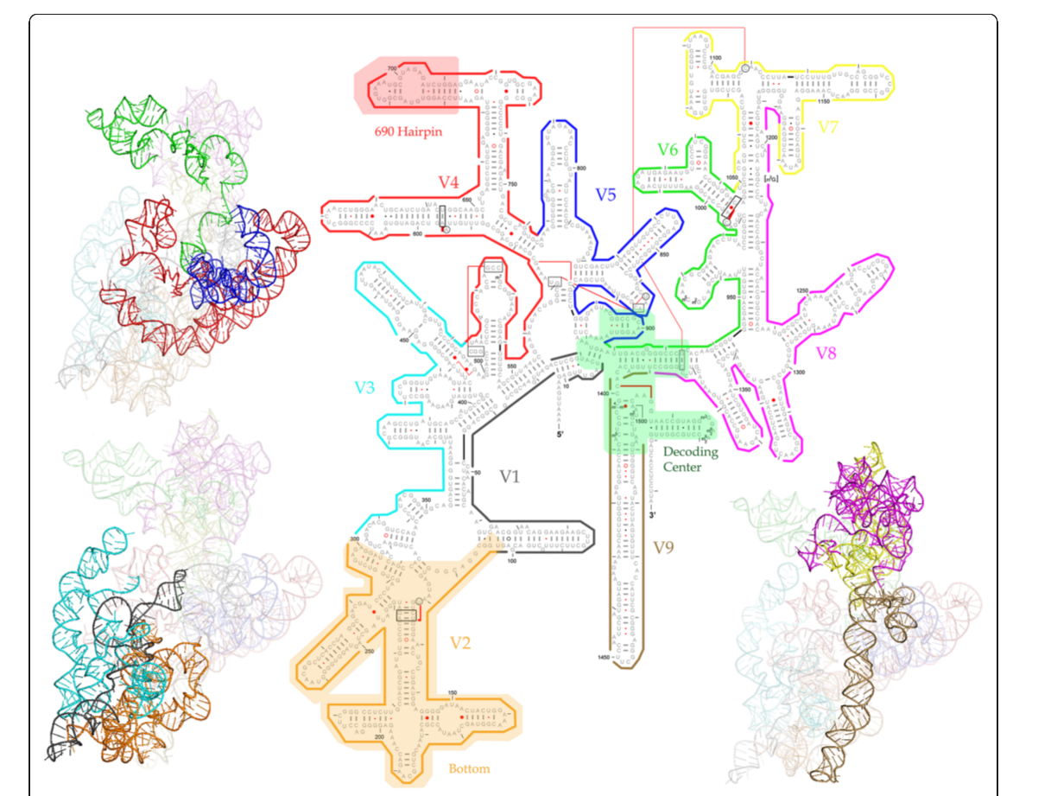
What part of the 16S gene are we amplifying?
Notes:
Originally, sanger sequencing. Then 454. Then 100bp of the miseq was enough to get a sense of variability.

Slide 23


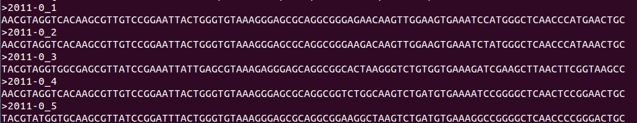
How do we cluster 16S sequences?
??
??
3%
3%

Slide 24
How do we cluster 16S sequences?
3%

Slide 25
How to do 100,000² / 2 alignments?
Use a greedy approach
Only align against the cluster centroids instead of every sequence
Use kmer matching to prioritize alignments
Don’t search the whole database, only the top 32 clusters

Slide 26
vsearch / usearch / uclust
First read

Slide 27
vsearch / usearch / uclust
>97% ID?
Second read

Slide 28
vsearch / usearch / uclust
>97% ID?
Third read

Slide 29
vsearch / usearch / uclust
Align against the centroid of the cluster with the next highest kmer overlap
<97% identity
Align against the cluster with highest kmer overlap
Once we’ve checked enough (32) sequence clusters, start a new cluster
Next read
<97% identity

Slide 30
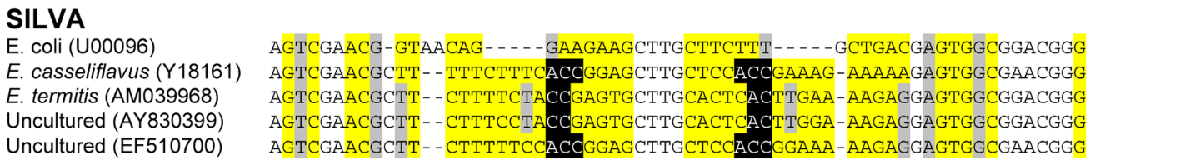
Assigning taxonomy
BLAST / uclust

Slide 31
Final data
Species | OTU Counts | Relative abundance
E. coli | 5 | 0.56
B. fragilis | 3 | 0.33
Clostridia unclassified | 1 | 0.11
Notes:
The final data look like this. Each of your OTUs, has a species assignment, and a number of 16S counts. Generally you would normalize these to obtain a relative abundance.

Slide 32
Data is very high dimensional
Samples probably have a few hundred strains
OTU clustering can yield a dataset with >10,000 OTUs

Slide 33
The math of PCA
Vector projections
The definition of PCA
Useful matrix factorizations

Slide 34
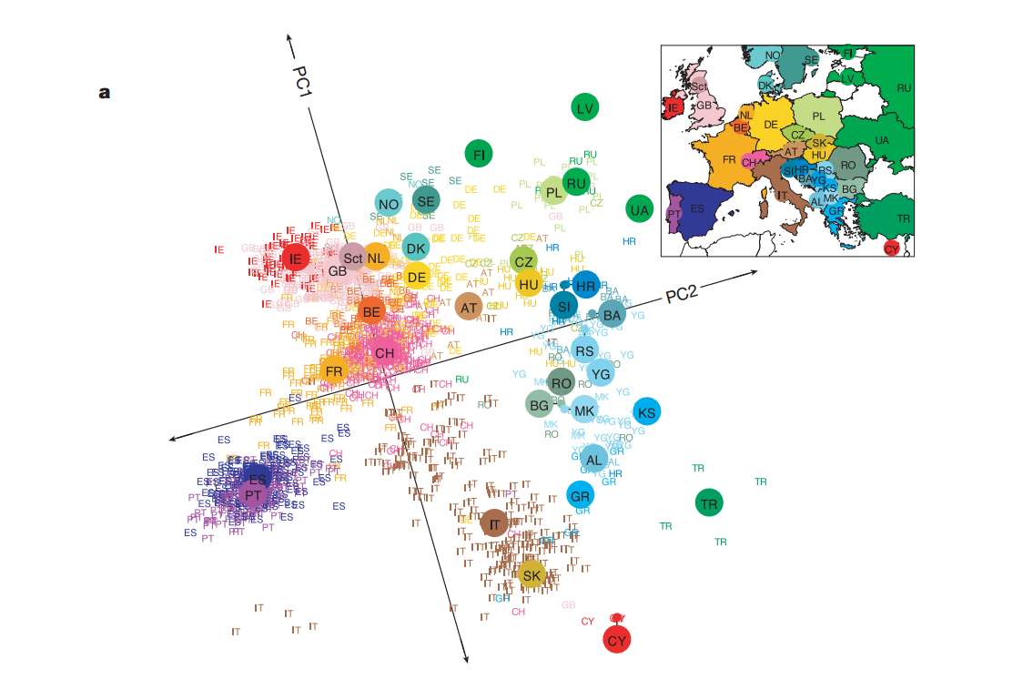
Side note: PCA and European genetics
Novembre et al. 2008

Slide 35
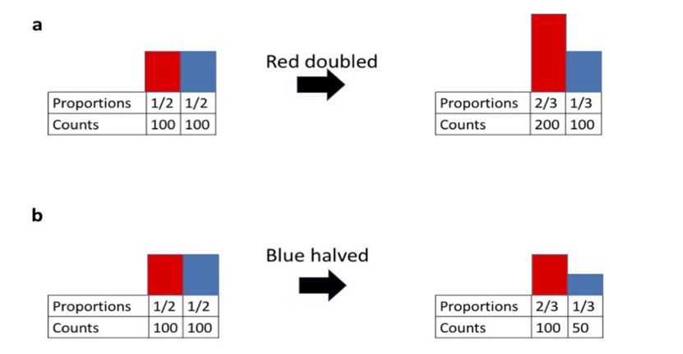
What’s the problem with using PCA for this analysis?
Microbiome data is compositional, they add up to 100%
Morton et al. 2017

Slide 36
PCOA – a poor man’s PCA
Max already talked about this, quick refresher
PCA – Dimensionality reduction by finding vectors which maximize the variance of the data
PCOA – Dimensionality reduction by embedding data in a Euclidean space which conserves distances between points

Slide 37
PCOA does have one advantage
Community A
Community B
✓
✓
✓
✓
✓
✓
L. lactis
B. fragilis
E. coli
L. lactis
B. fragilis
E. coli
E. faecalis
D. vulgaris
E. faecalis
D. vulgaris
Notes:
two

Slide 38
Back to our original question

Slide 39
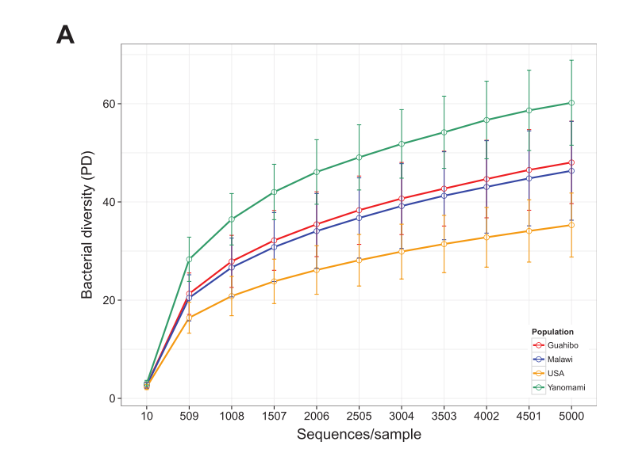
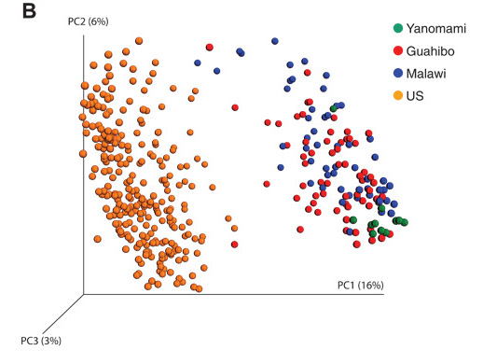
The industrialized microbiome is different

